Slide 1
Decimal, Binary, Octal and Hexadecimal Number Systems- Number Base Conversions. Addition, Subtraction, Multiplication and Division of binary numbers. Representation of negative numbers- Complements, Subtraction with complements. Addition and subtraction of BCD, Octal and Hexadecimal numbers. Binary codes- Decimal codes, Error detection codes, Reflected code, Character coding schemes – ASCII, EBCDIC.
Module I Number systems, Operations & Codes

Slide 2
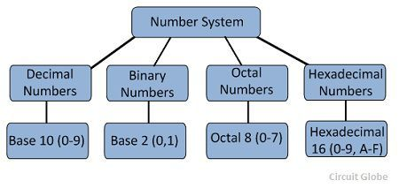
The base or radix of the number system is the total number of symbols used to denoted the numbers in the number system.

Slide 3
The system of numbers which has base or radix 10, i.e. uses total 10 symbols to represent numbers of the system is called decimal number system. The symbols used in the decimal number system are 0, 1, 2, 3, 4, 5, 6, 7, 8, 9; where each of these symbols assigned a specific value.
A number system with base or radix 2 is called binary number system. The binary number system uses only 2 symbols (0 and 1) to represent binary numbers. All modern digital devices like computers, combinational circuits, sequential circuits, etc. use the binary number system to operate.
A number system which has base 8 is called an octal number system. Therefore, the octal number system uses 8 symbols, (0, 1, 2, 3, 4, 5, 6, 7) to represent the number.
Hexadecimal Number System- The number system with base or radix 16 is called as hexadecimal number system. Thus, the hexadecimal number system uses 16 symbol to represent numbers. These symbols are 0, 1, 2, 3, 4, 5, 6, 7, 8, 9, A, B, C, D, E, F. Where, A = 10; B = 11; C = 12; D = 13; E = 14; F = 15.
The hexadecimal number system is extensively used in microprocessors and microcontrollers. The most significant advantage of hexadecimal number system over binary number system is that the hexadecimal numbers are much shorter in size than the binary numbers, which makes these hexadecimal numbers more readable.

Slide 4
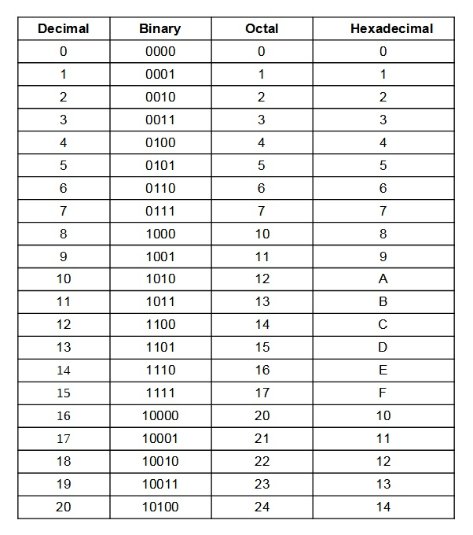

Slide 5
Conversion of Binary to other Number Systems
Binary to Decimal Conversion
Example 1: (10110)₂
We multiplied each bit of (10110)₂ with its respective positional weight, and last we add the products of all the bits with its weight.
(10110)₂ = (1×2⁴)+(0×2³)+(1×2²)+(1×2¹)+(0×2⁰)
= (1×16)+(0×8)+(1×4)+(1×2)+(0×1)
=16+0+4+2+0
=(22)₁₀
Example 2 : (10110.001)₂
(10110.001)₂ =(1×2⁴)+(0×2³)+(1×2²)+(1×2¹)+(0×2⁰)+(0×2⁻¹)+(0×2⁻²)+(1×2⁻³)
=(1×16)+(0×8)+(1×4)+(1×2)+(0×1)+(0×1⁄2)+(0×1⁄4)+(1×1⁄8)
=16+0+4+2+0+0+0+0.125 =(22.125 )₁₀

Slide 6
Convert the following binary number to decimal
10101₂
11011.101₂
1001011₂

Slide 7
Binary to Octal Conversion
Example 1: (111110101011.0011)₂
1. Firstly, we make pairs of three bits on both sides of the binary point.
111 110 101 011.001 1
On the right side of the binary point, the last pair has only one bit. To make it a complete pair of three bits, we added two zeros on the extreme side.
111 110 101 011.001 100
2. Then, we wrote the octal digits, which correspond to each pair.
(111110101011.0011)₂=(7653.14)₈
Convert the following binary numbers to octal.
110101.101010
1010
1111.1
10101111001.0111

Slide 8
Binary to Hexadecimal Conversion
Example 1: (11110101011.0011)₂
1. Firstly, we make pairs of four bits on both sides of the binary point.
111 1010 1011.0011
On the left side of the binary point, the first pair has three bits. To make it a complete pair of four bits, add one zero on the extreme side.
0111 1010 1011.0011
2. Then, we write the hexadecimal digits, which correspond to each pair.
(011110101011.0011)₂=(7AB.3)₁₆
Convert the following binary numbers to octal.
1011011011=0010 1101 1011= 2DB
01011111011.011111= 0010 1111 1011.0111 1100= 2FB.7C

Slide 9
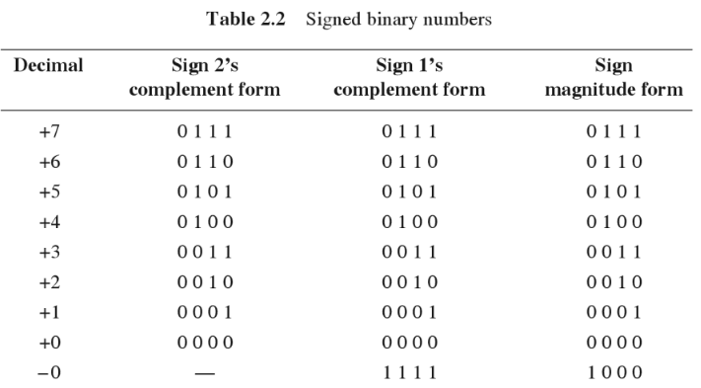
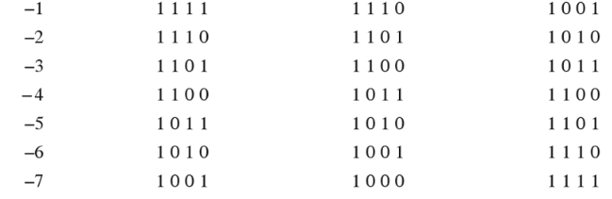

Slide 10
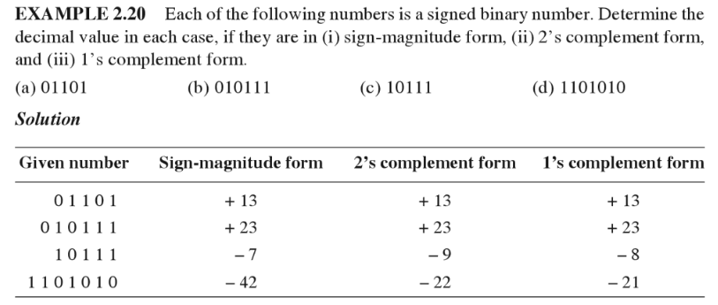

Slide 11


Slide 12

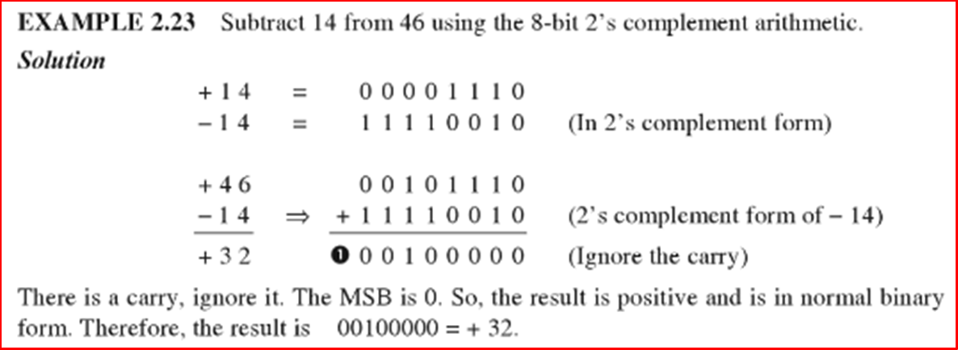

Slide 13
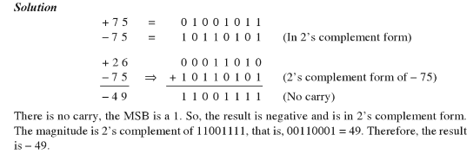

Slide 14
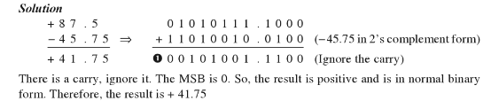

Slide 15


Slide 16
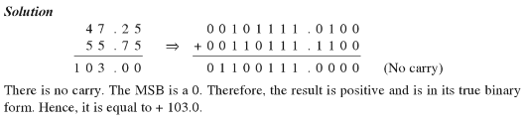

Slide 17
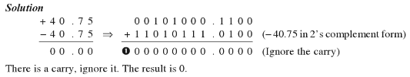

Slide 18
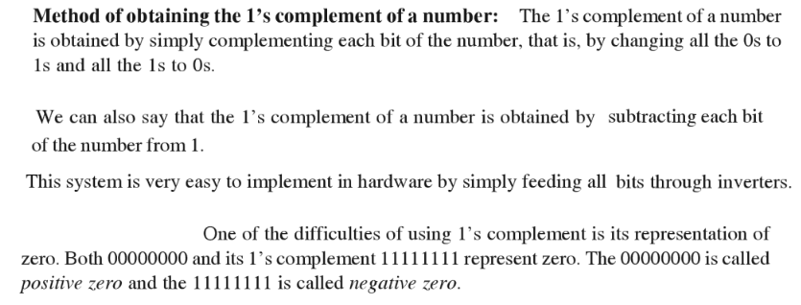

Slide 19
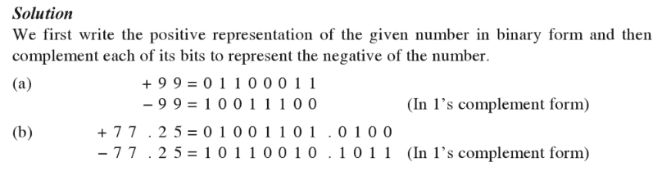

Slide 20
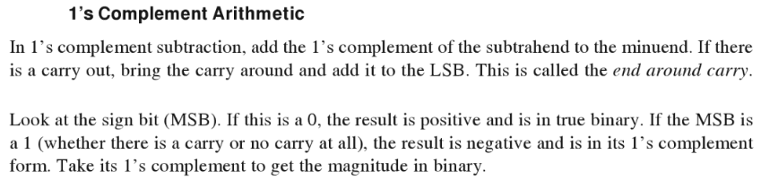

Slide 21
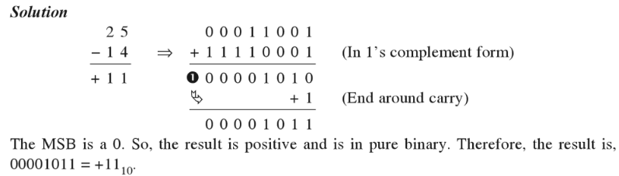

Slide 22
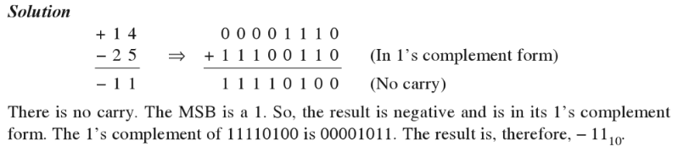

Slide 23
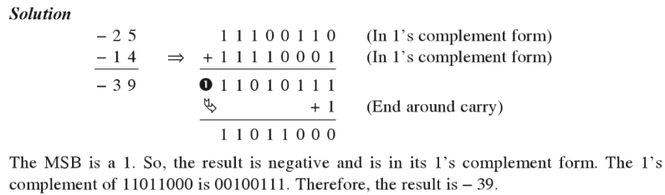

Slide 24
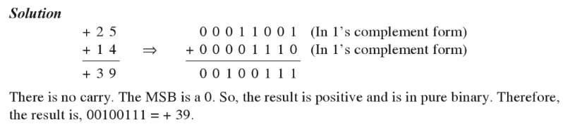

Slide 25
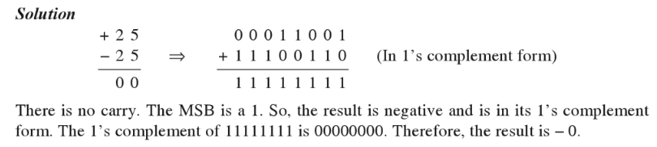

Slide 26
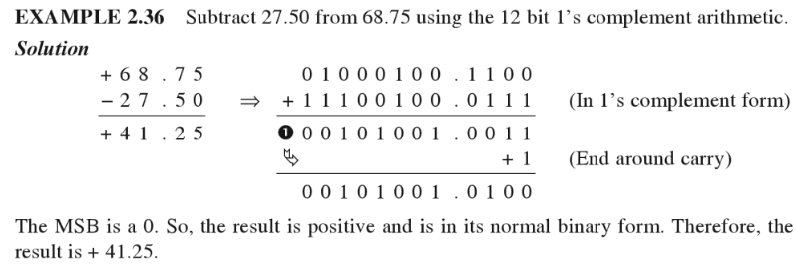

Slide 27
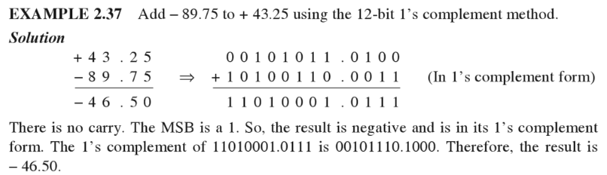

Slide 28

Octal Number System
Positional Weighted system
Since its base is 8=2³ ,every 3 bit group of binary can be represented by an
octal digit.
The Octal Number system is widely used in computer application sectors
and digital numbering systems.

Slide 29
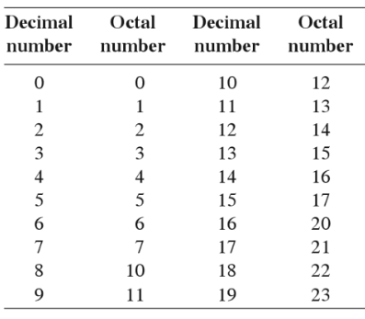

Slide 30
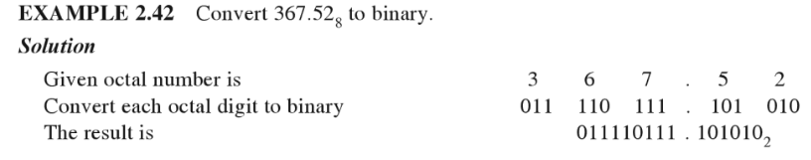

Slide 31
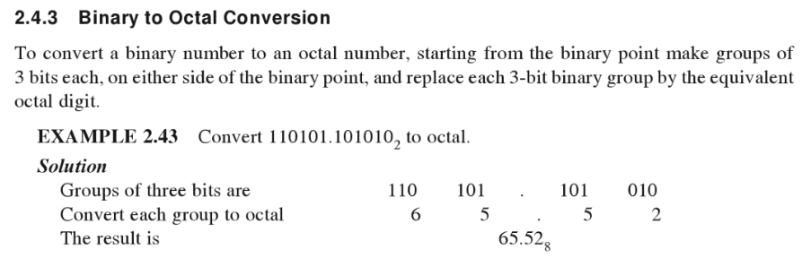

Slide 32
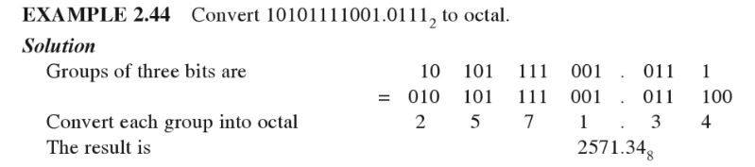

Slide 33
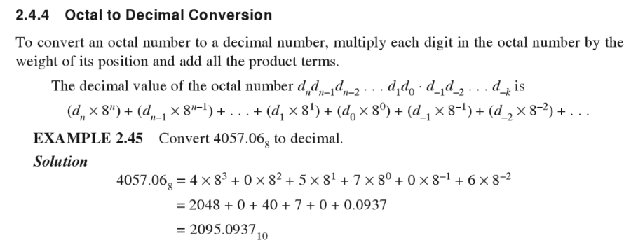

Slide 34
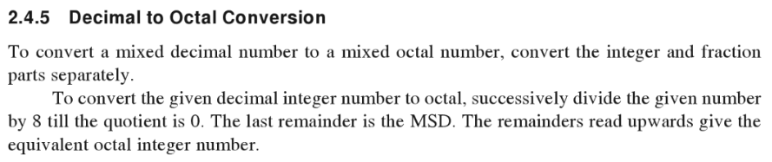
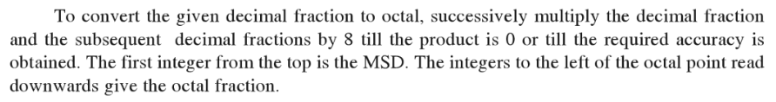

Slide 35
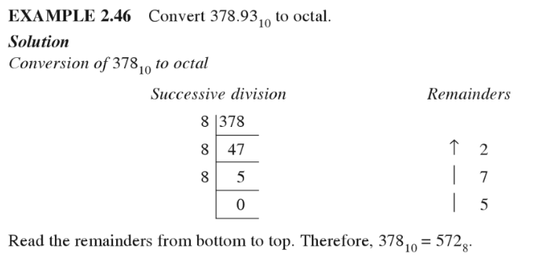

Slide 36
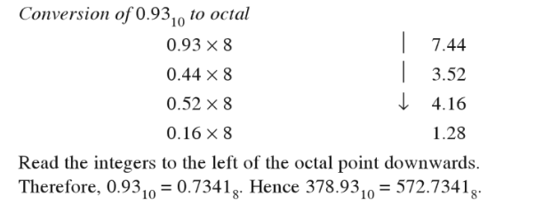

Slide 37
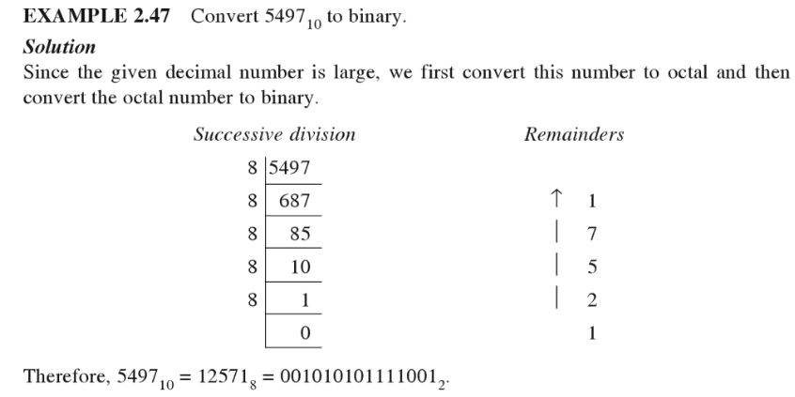

Slide 38
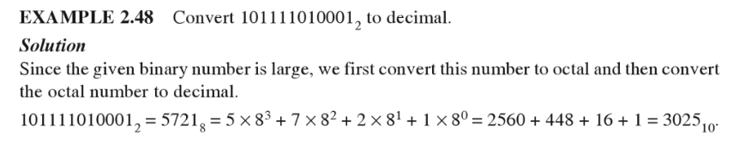

Slide 39

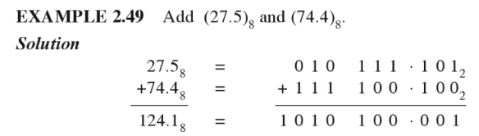

Slide 40
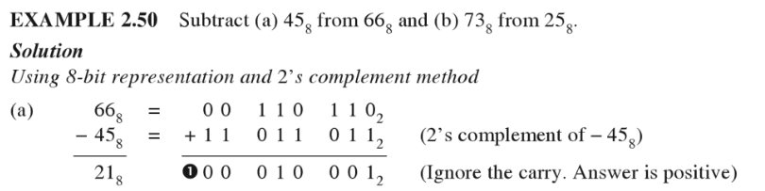

Slide 41
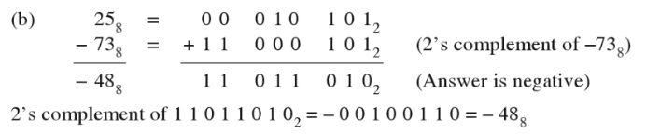
46₈

Slide 42
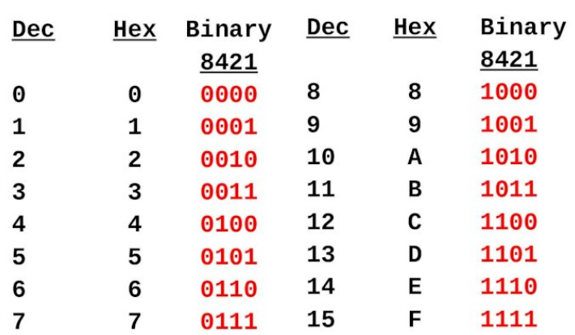
Hexadecimal number system
The hexadecimal number system is described as a 16 digit number representation of numbers from 0 - 9 and digits from A – F. Base=16

Slide 43
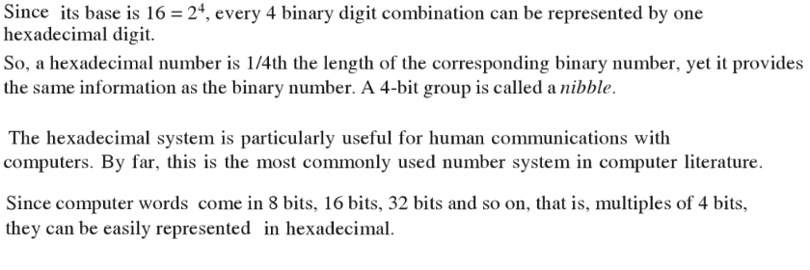

Slide 44
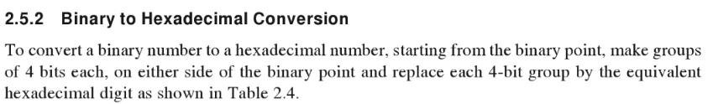
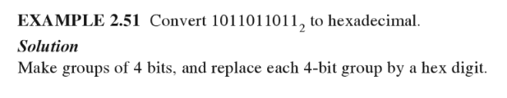
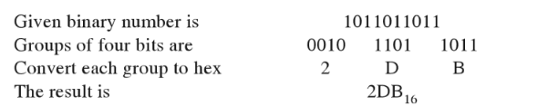

Slide 45
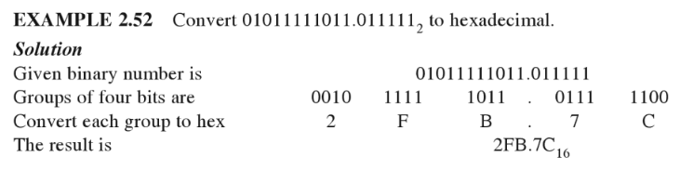

Slide 46
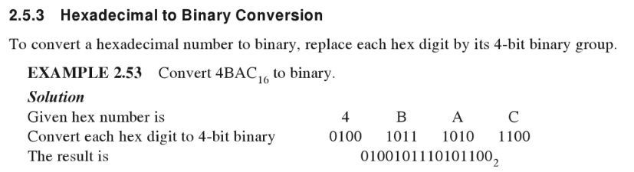

Slide 47
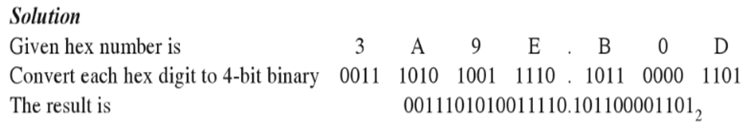

Slide 48
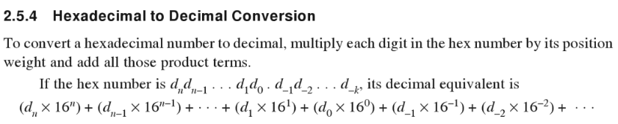

Slide 49
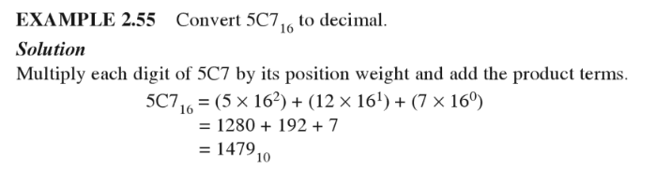

Slide 50
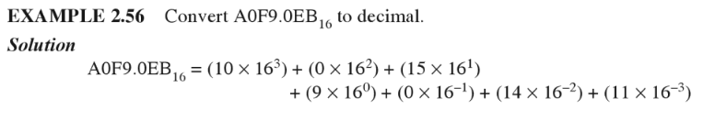


Slide 51
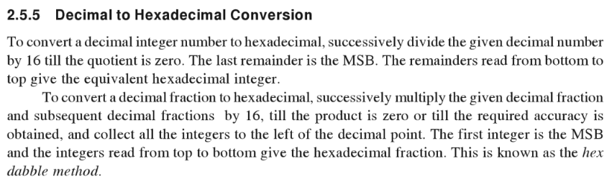

Slide 52
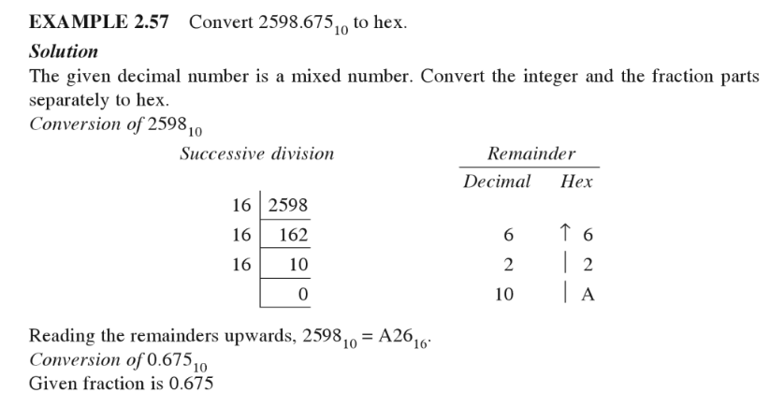

Slide 53
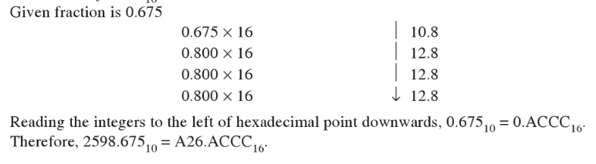

Slide 54
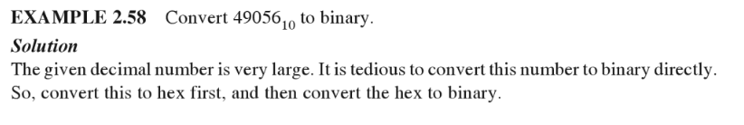
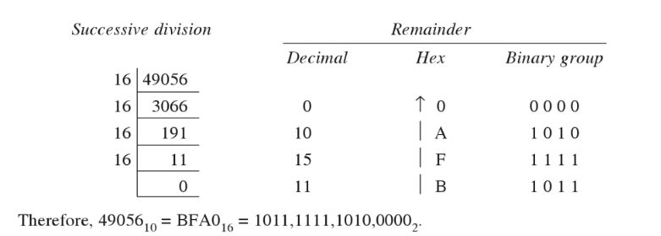

Slide 55


Slide 56


Slide 57


Slide 58


Hexadecimal Arithmetic
Try: Add C5₁₆ and A3₁₆

Slide 59



Slide 60




Slide 61

Binary Coded Decimal (BCD) code
BCD is a way to express each of the decimal digits with a binary code.
In the Binary, with four bits we can represent sixteen numbers (0000 to 1111).
But in BCD code only first ten of these are used (0000 to 1001).
The remaining six code combinations i.e. 1010 to 1111 are invalid in BCD.

Slide 62
BCD Addition
The addition of BCD numbers is slightly different from binary addition.
Here, the rules of binary addition are partially applicable only to the individual 4-bit groups.
The BCD addition, is thus carried out by individually adding the corresponding 4-bit groups starting from the LSB side.
If there is a carry to the next group, or if the result belongs to any of the 6 illegal states than we add 6₁₀(0110) to the sum term of that group and resulting carry is added in the next group.

Slide 63


Slide 64


Slide 65

BCD Subtraction

Slide 66



Slide 67


Slide 68

Excess-3 code (or XS3)
The excess-3 code (or XS3) is a non-weighted BCD code.
We will get the Excess 3 code of a decimal number by adding three (0011) to the binary equivalent of that decimal number. Hence, it is called as Excess 3 code.

Slide 69
Gray Code
The Gray code is non-weighted code, as the position of bit does not contain any weight.
The Gray code is a reflective digital code which has the special property that any two subsequent numbers codes differ by only one bit. This is also called a unit- distance code.

Slide 70

Binary to Gray code conversion
The most significant bit (MSB) of the Gray code is always equal to the MSB of the given binary code other bits of the output Gray code can be obtained by Xoring binary code bit at that index and previous index.
The binary to Gray code conversions can be done by using XOR logic gate. The input is binary code and the output is equivalent Gray code.
(XOR Gate)

Slide 71


Binary to Gray code conversion

Slide 72



Slide 73

Convert (10)₁₀ into Gray Code.
Solution:
Firstly, we convert decimal number to binary number and then convert binary to gray code.
Therefore (10)₁₀ = (1111)_{g}
Note: Conversion from any number system to Gray code or Gray code to any number system can be asked

Slide 74


Gray to Binary Conversion
G3
G2
G1
G0
B3
B2
B1
B0

Slide 75

G3
G2
G1
G0
B3
B2
B1
B0

Slide 76


1. Convert (110011100)_{g} to binary number.
Therefore, (110011100)_{g} = (100010111)₂
2. Convert (101010101)_{g} to binary number.
Therefore, (101010101)_{g} = (110011001)₂

Slide 77

why gray code is also called reflective code?
Gray code also known as reflected binary code, because the last (n/2) values are reflection of the first (n/2) values.

Slide 78
PARITY BIT - Error-Detection Codes
A parity bit is an extra bit appended onto the code word to make the number of 1’s odd or even.
Parity can detect all single-bit errors and some multiple-bit errors (rarely).
The parity code is used for the purpose of detecting errors during the transmission of binary information in communication system.
A code word has even parity if the number of 1’s in the code word is even.
A code word has odd parity if the number of 1’s in the code word is odd.

Slide 79


Slide 80


Slide 81


Slide 82

Block Parity
When several binary words are transmitted and received at a time, then such information is regarded as a block of data, having rows and columns.
For example, let us consider four eight-bit words, which are to be transmitted, forms a 4 x 8 block. Parity bits are assigned to both rows and columns.

Slide 83
As shown in example, even parity is given to each eight-bit word and for each column. In this case, the parity bit is called block parity.
The block of data is transmitted from the transmitter side.
Upon analyzing the received block of data(b), the first row has no error as the even parity is maintained. In the second row, the even parity is changed to odd parity. So there is an error in the 2nd row. Even parity is maintained in the third and fourth row and thus, there is no error.
To find out the error bit in the second row, let’s check the column-wise parity. If you do so, in the 2nd column, you can notice the even parity is changed to odd parity. So there is an error in the second column. In all other columns, there is no change in the even parity and hence no error in other columns.

Slide 84
ALPHANUMERIC CODES
A binary digit or bit can represent only two symbols as it has only two states '0' or '1'. For the communication between two computers or I/O devices like printers, keyboard etc, we need many more symbols for communication.
These symbols are required to represent 26 alphabets with capital and small letters, numbers from 0 to 9, !,@,#,{,]……. and other symbols.
ie., The alphanumeric codes are the codes that represent, and alphabets and characters. They use bit pattern for wide range of symbols.
The following three alphanumeric codes are very commonly used for the data representation.
American Standard Code for Information Interchange (ASCII).
Extended Binary Coded Decimal Interchange Code (EBCDIC).

Slide 85

American Standard Code for Information Interchange(ASCII) Codes
ASCII code is a 7-bit code,ie.2⁷=128 different patterns can be created. ASCII code is more commonly used in world wide. It is a standard data-encoding format for electronic communication between computers.

Slide 86

EBCDIC is an 8-bit alphanumeric code, 2⁸=256 patterns can be created. while EBCDIC is used primarily in large IBM computers

